Slide 1

Virtualization

Slide 2

Types of Virtualization
Server Virtualization.
Desktop Virtualization.
Application Virtualization.
OS Virtualization.
Network Virtualization.
Storage Virtualization.

Slide 3
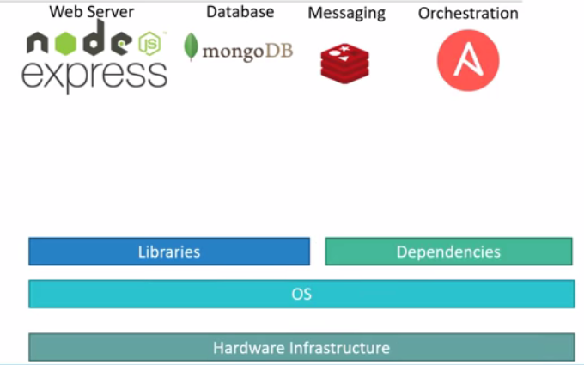
OS Virtualization

Slide 4
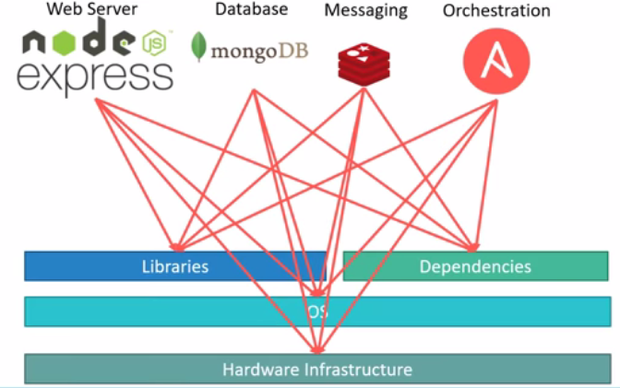
OS Virtualization

Slide 5
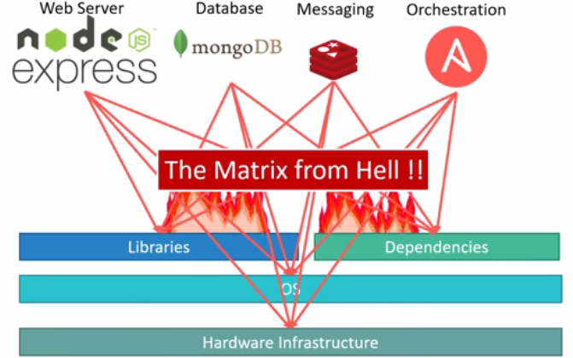
OS Virtualization

Slide 6
OS Virtualization
Compatibility/ Dependency.
Long Setup Time.
Different Dev/ Test/ Prod environments.

Slide 7
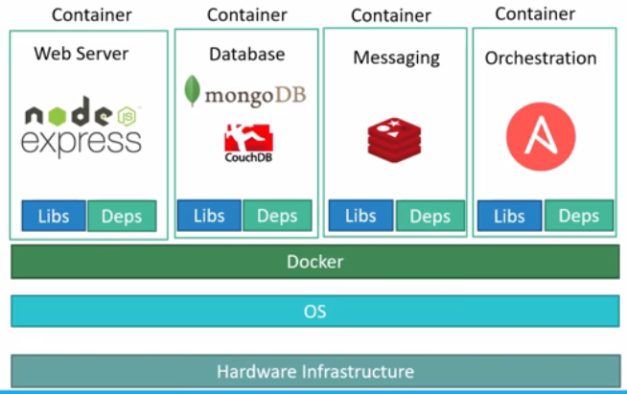
OS Virtualization

Slide 8
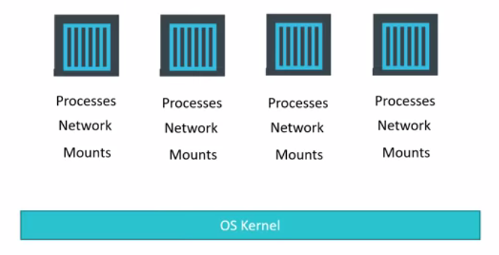
OS Virtualization

Slide 9
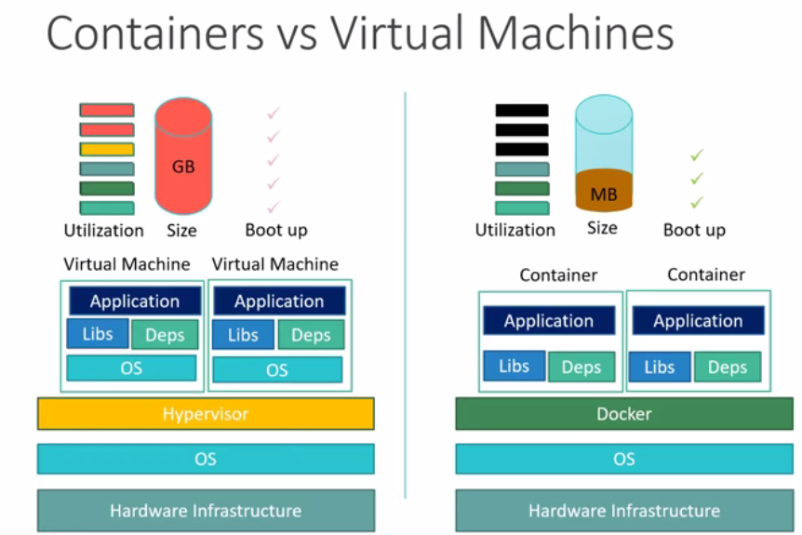
OS Virtualization

Slide 10
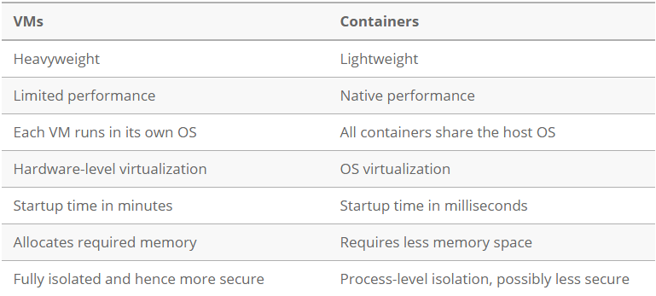
OS Virtualization

Slide 11
OS Virtualization
Benefits of Containers
Reduced IT management resources
Reduced size of snapshots
Quicker spinning up apps
Reduced & simplified security updates
Less code to transfer, migrate, upload workloads.
LXC, LXD, Docker, Windows Server Containers.

Slide 12
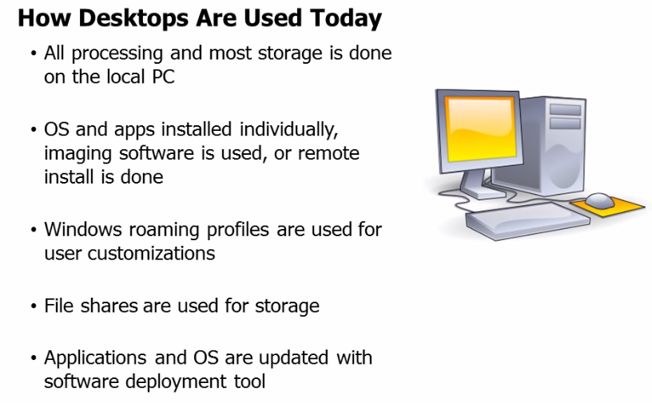
Desktop Virtualization

Slide 13
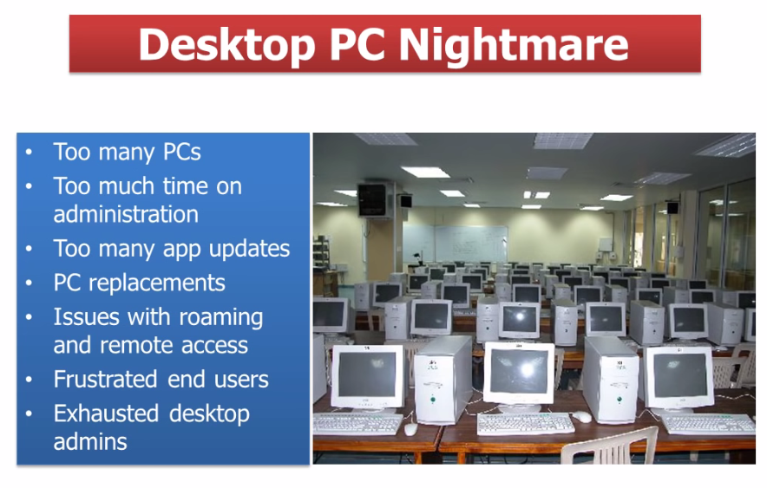
Desktop Virtualization

Slide 14
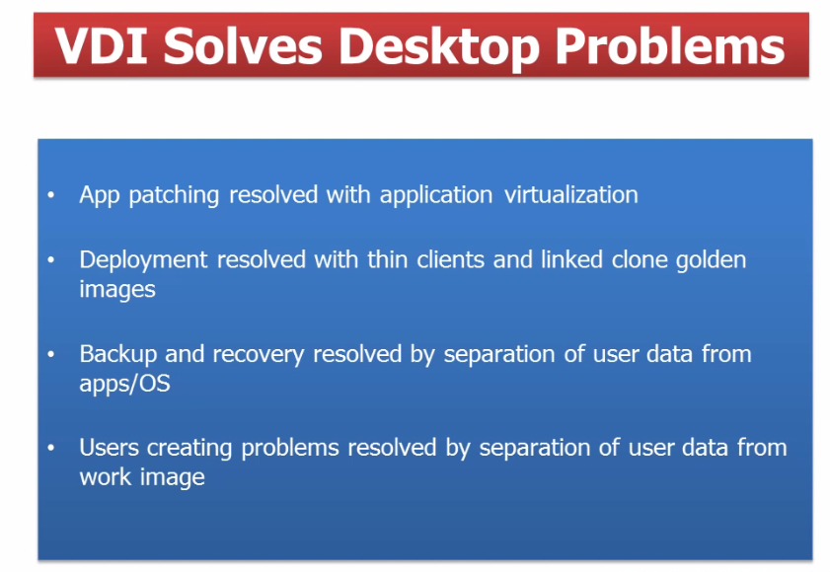
Desktop Virtualization

Slide 15
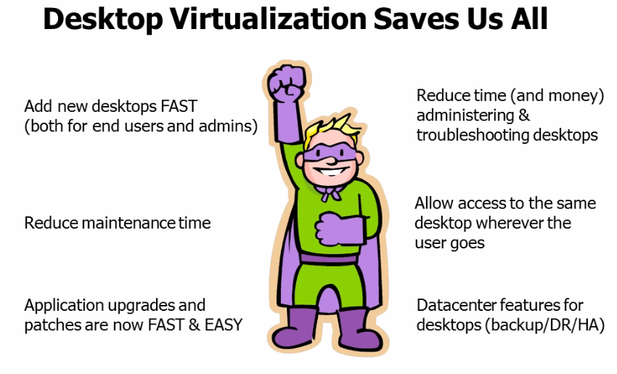
Desktop Virtualization

Slide 16
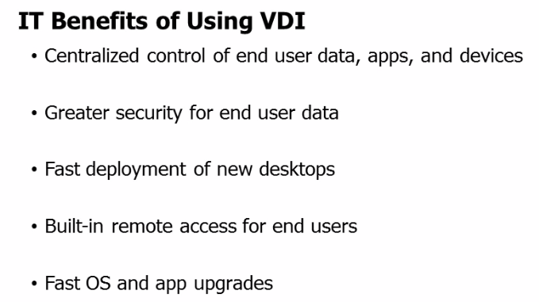
Desktop Virtualization

Slide 17
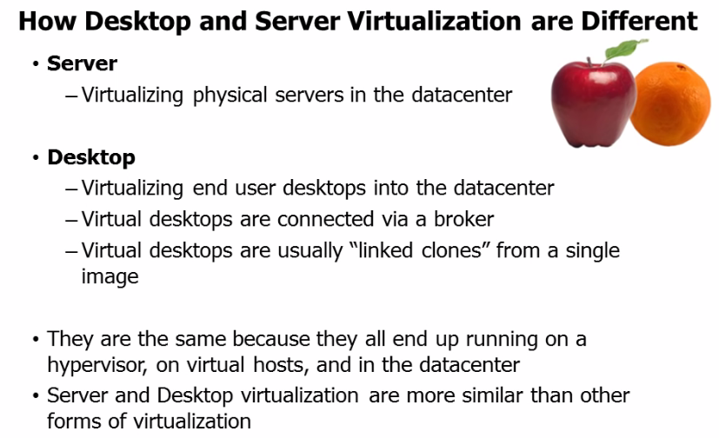
Desktop Virtualization

Slide 18
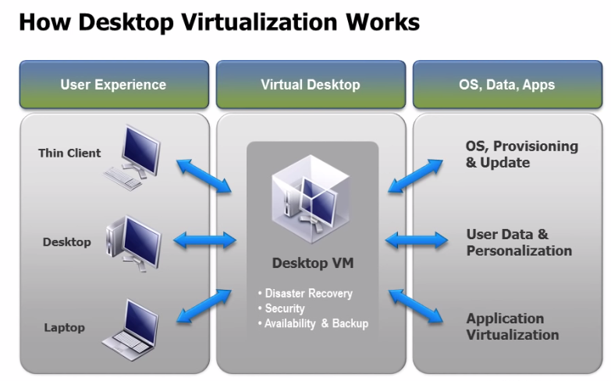
Desktop Virtualization

Slide 19
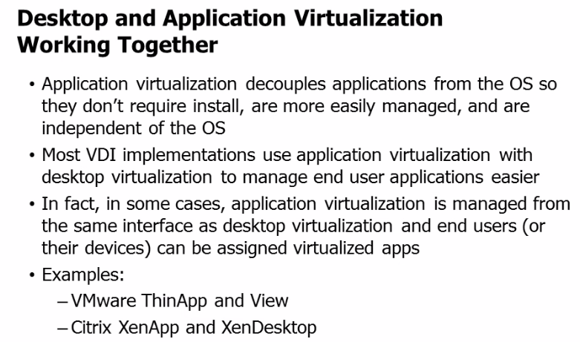
Desktop Virtualization

Slide 20
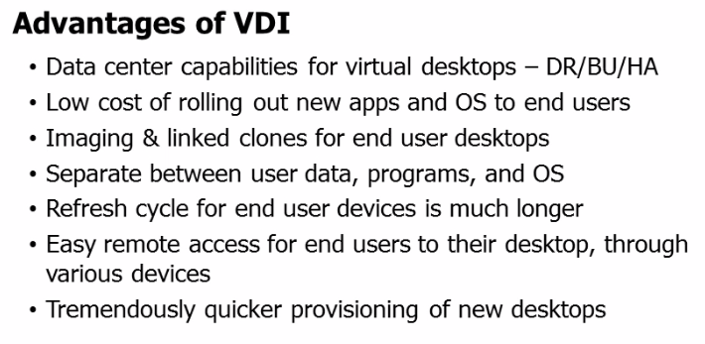
Desktop Virtualization

Slide 21
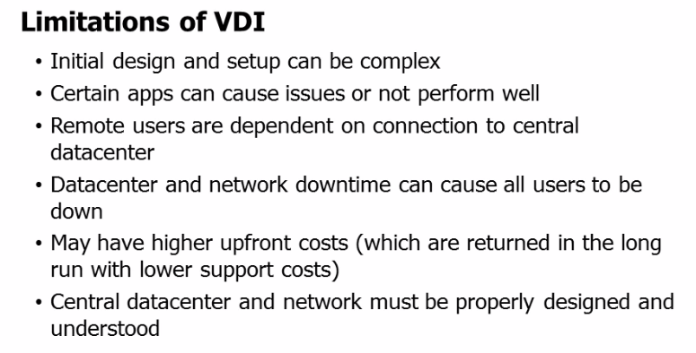
Desktop Virtualization

Slide 22
Application Virtualization
Encapsulates computer programs from the underlying operating system on which they are executed.
A fully virtualized application is not installed in the traditional sense.
The application behaves at runtime like it is directly interfacing with the original operating system and all the resources managed by it, but can be isolated or sandboxed to varying degrees.

Slide 23
Application Virtualization
The layer intercepts all disk operations of virtualized applications and transparently redirects them to a virtualized location, often a single file.
The application remains unaware that it accesses a virtual resource instead of a physical one.

Slide 24
Application Virtualization
Since the application is now working with one file instead of many files spread throughout the system, it becomes easy to run the application on a different computer and previously incompatible applications can be run side by side.
Cameyo, Ceedo, Citrix XenApp, Microsoft App-V, VMWare ThinApp.

Slide 25
Application Virtualization Benefits
Allows applications to run in environments that do not suit the native application.
Reduces system integration and administration costs by maintaining a common software baseline across multiple diverse computers in an organization.
Lesser integration protects the operating system and other applications from poorly written or buggy code.

Slide 26
Application Virtualization Benefits
It allows incompatible applications to run side by side.
Isolating applications from the operating system has security benefits as well, as the exposure of the application does automatically entail the exposure of the entire OS.
Application virtualization uses fewer resources than a separate virtual machine.

Slide 27
VPN

Slide 28
VPN
A virtual private network (VPN) extends a private network across a public network, and enables users to send and receive data across shared or public networks as if their computing devices were directly connected to the private network.
Applications running across a VPN may therefore benefit from the functionality, security, and management of the private network.
Encryption is a common though not an inherent part of a VPN connection.

Slide 29
VPN
VPN technology was developed to allow remote users and branch offices to access corporate applications and resources. To ensure security, the private network connection is established using an encrypted layered tunnelling protocol and VPN users use authentication methods, including passwords or certificates, to gain access to the VPN.

Slide 30
Types
Types of VPN: Site- to- Site VPN and Remote- access VPN.
Site- to- Site VPN: Allow a company to connect its remote sites to the corporate backbone securely over internet.
Remote- Access VPN: Allow remote user like telecommuters to securely access the corporate network wherever and they need to.

Slide 31
Cont..
Security over Internet: VPN uses IPsec to provide secure communication over internet.
Allow for secure data transmission over an IP- based network.
Data confidentiality.
Data integrity.
Data origin authentication.

Slide 32
Ways to Implement VPN
Three ways to implement VPN:
Generic Routing Encapsulation (GRE): Peer to Peer, No encryption, Manual Tunnel, Not Scalable, Static IP on all End Points.
Dynamic Multi- point VPN (DMVPN): Multi point, uses NHRP(Next Hop Resolution Protocol) protocol.
IPSec: Provides encryption, confidentiality, data integrity, authentication, replay detection.

Slide 33
Cont..
DMVPN:
Automatically creates VPN tunnels when dynamic IP address on the both ends are used.
Keeping cost low, minimising configuration complexity and increasing flexibility.
NHRP: Maintains tunnel end point IP address with their public IP Address.

Slide 34
Cont..
IPSec VPN:
Allow two or more hosts to communicate in a secure manner by authenticating and encryption each IP packet of a communication session.
Provides confidentiality, data integrity, authentication, replay detection.
Virtual tunnel between two endpoints.

Slide 35
Cont..
VPN client packet into VPN server.
VPN gave a secure way to connect to a company’s intranet.
Information between VPN server and the destination server are subjected to normal internet traffic rules.
Open VPN, IKEv2(Microsoft & Cisco)
VPN server needs to know where data is going and who to send it to.

